Slide 1
React Native
ReactJS for mobile applications
Satvik Jagannath
Software Development Engineer,
CISCO

Slide 2
ReactJS
by Facebook
in 2013
Facebook, Instagram, Airbnb, Wordpress, Automattic, BBC, Flipkart, Myntra, Facebook Ads app, Box, Coursera, Dropbox, Dailymotion, Flipboard, IMDB, Hipchat, Khan Academy, Netflix, OkCupid, Paypal, Quizup, Reddit, Salesforce, Whatsapp, Wired, Yahoo, Atom Editor, Brackets Editor, Firefox Hello etc.,
100’s of others - Facebook Github

Slide 3


Slide 4
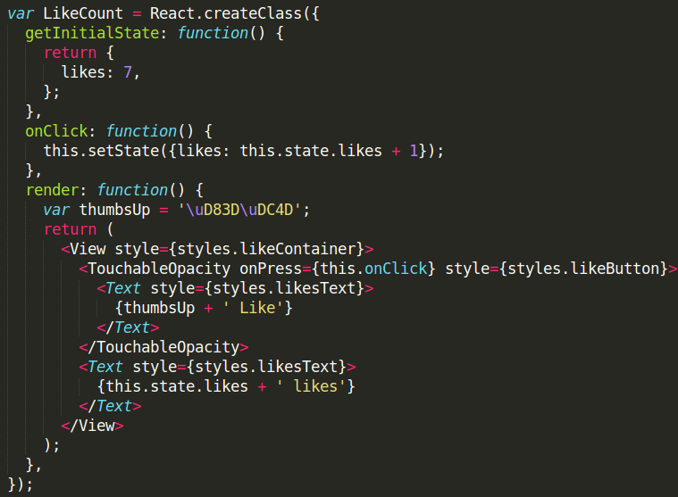
Hello ReactJS
UGLY?
Templating language!!
Separation of Concerns
-_-

Slide 5
Hello ReactJS
It’s just Javascript
JSX Syntax
You better like it ;)

Slide 6
Hello ReactJS
2 way binding like Angular?
Models? Controllers?
Where is directives?
Global Event listener?
Templates?...
Works with Backbone?
Can I also use jQuery? ;)
I know jQuery, not JS!
is this JS?

Slide 7


Slide 8
React has no
Controllers

Slide 9
React has no
Controllers
Directives

Slide 10
React has no
Controllers
Directives
Templates

Slide 11
React has no
Controllers
Directives
Templates
Global Event Listener

Slide 12
React has no
Controllers
Directives
Templates
Global Event Listener
Models

Slide 13
React has no
Controllers
Directives
Templates
Global Event Listener
Models
View-Models

Slide 14
React has no
Controllers
Directives
Templates
Global Event Listener
Models
View-Models
Blah
Blah Blah
Blah Blah Blah

Slide 15
React has
COMPONENTS

Slide 16
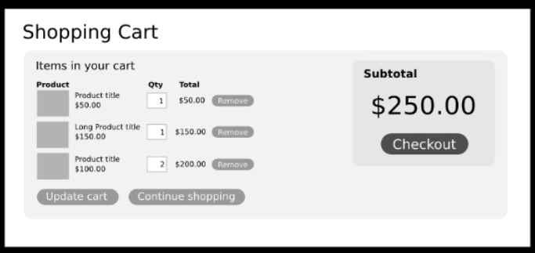
How do you separate concerns?

Slide 17
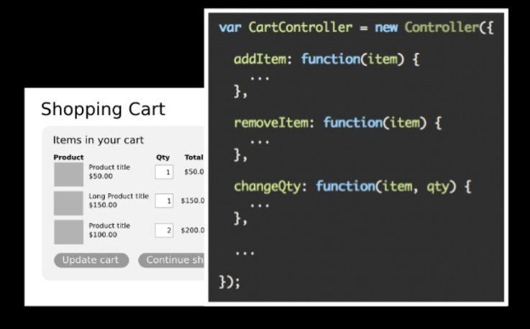
Angular - Separation.

Slide 18
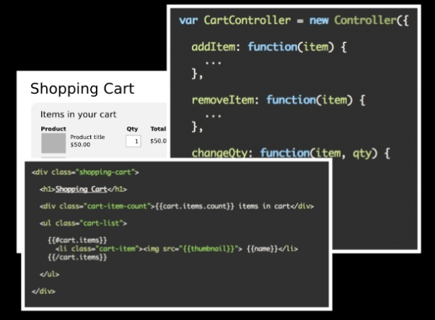
Ember Separation ..

Slide 19
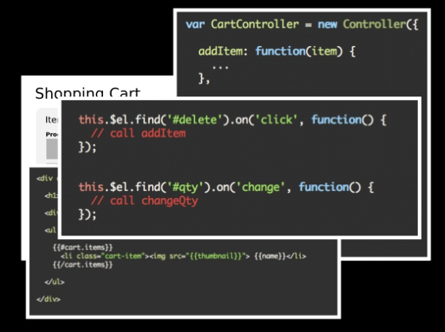
Backbone Separation...

Slide 20
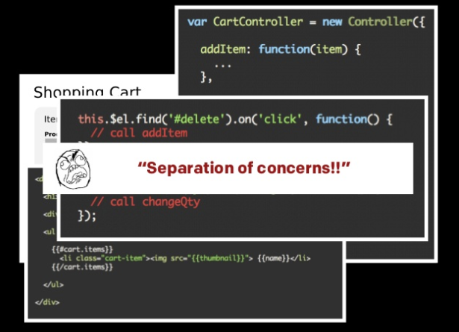

Slide 21
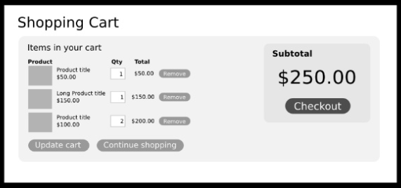
What if we Separate in ANOTHER way?

Slide 22
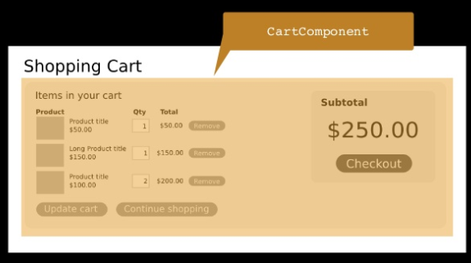
What if we Separate in ANOTHER way?

Slide 23
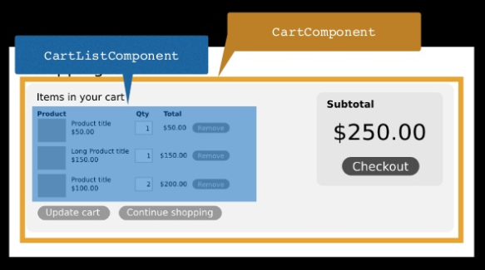
What if we Separate in ANOTHER way?

Slide 24
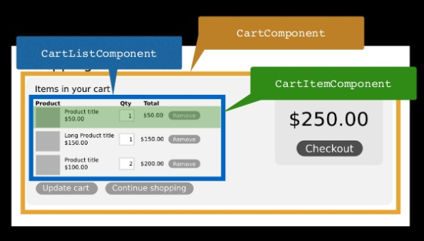
What if we Separate in ANOTHER way?

Slide 25
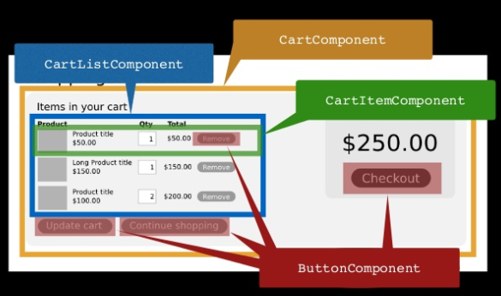
What if we Separate in ANOTHER way?

Slide 26

Yay baby!

Slide 27
Separation of Components!
Composable
Reusable
Maintainable
Testable
IF AND ONLY IF, components are self-contained.

Slide 28
Data flow
Pure JS - Any component can communicate with any other component
Backbone - Publisher Subscriber model
item.on(‘change:name’, function() { ...
Angular - 2 way data binding & $digest loop
$scope.name = …
React - 1 way data “FLOW”

Slide 29
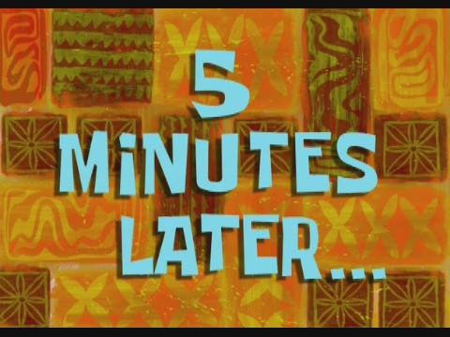
One Way data FLOW sounds GREAT!
That’s NOT how real world works!

Slide 30
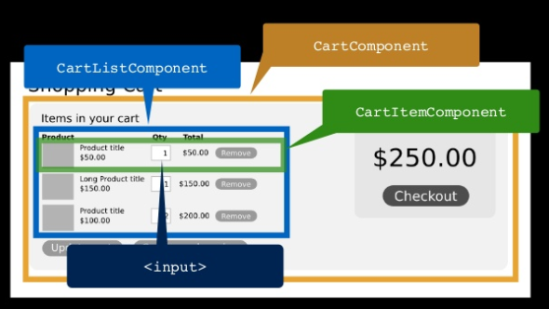

Slide 31
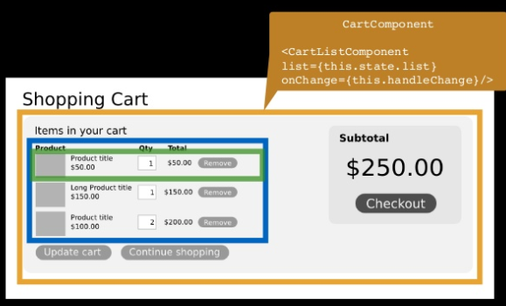
Data flows DOWN with handlers

Slide 32
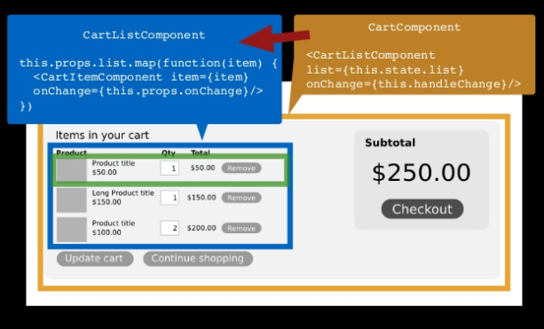
Data flows DOWN with handlers

Slide 33
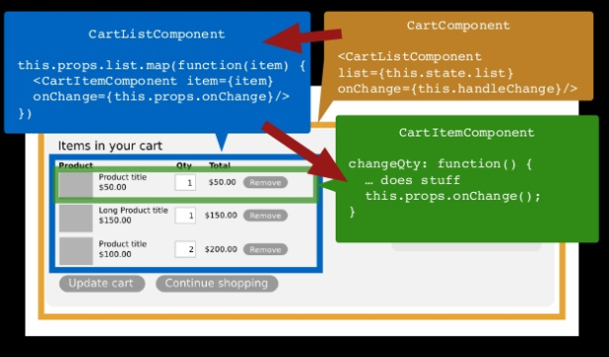
Data flows DOWN with handlers

Slide 34
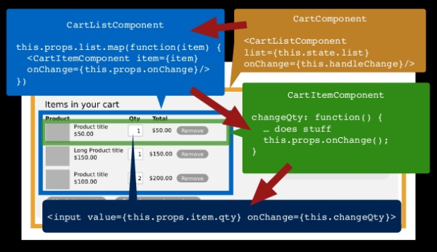
Data flows DOWN with handlers

Slide 35
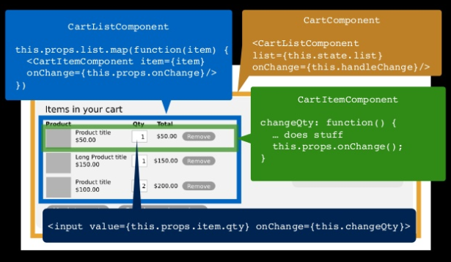
Here we gooooooo

Slide 36
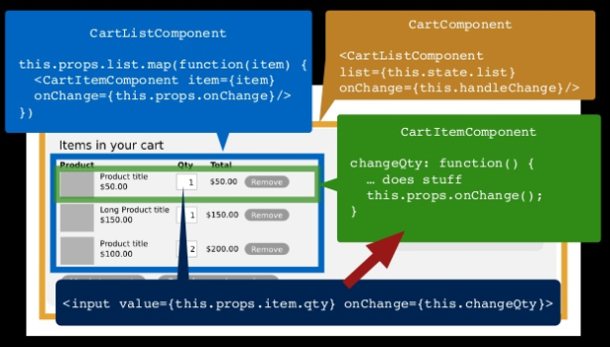
Event Flows UP

Slide 37
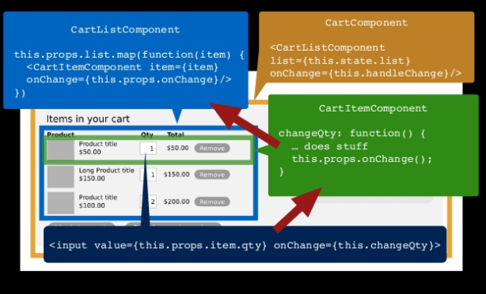
Event Flows UP

Slide 38
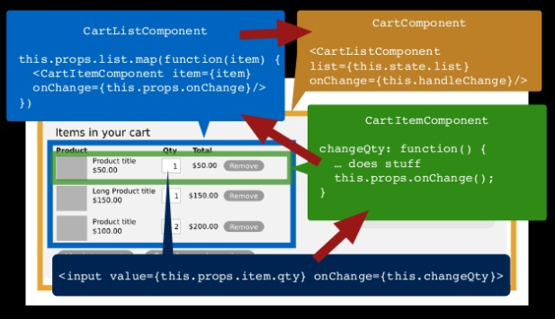
Event Flows UP

Slide 39
Data flows DOWN
Event Flows UP
Sounds familiar?

Slide 40
Data flows DOWN
Event Flows UP
That’s how DOM works!

Slide 41
Virtual DOM
React uses Virtual DOM
2 DOM’s will co-exist - Real and Virtual
What worse that having 2 DOM’s? Having 1 DOM!
Why not DOM?
Inconsistent
Hard to test
Brittle
Expensive operation

Slide 42
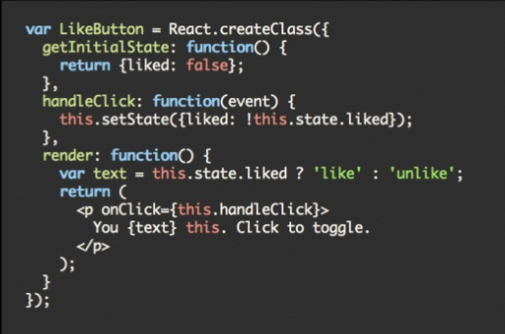
Back to JSX

Slide 43
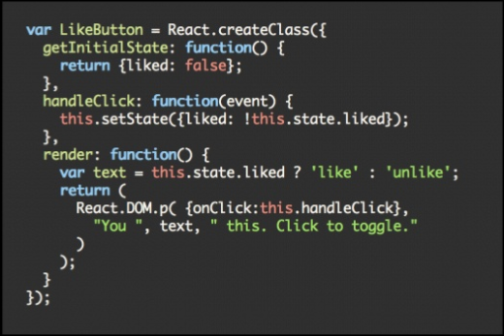
Compiled JSX

Slide 44
Virtual DOM
Pure JS, in-memory representation of DOM
render() fires when there is a change in state
React takes care of modifying the Real DOM to match the Virtual DOM
It’s fast
It’s pure
It just works

Slide 45
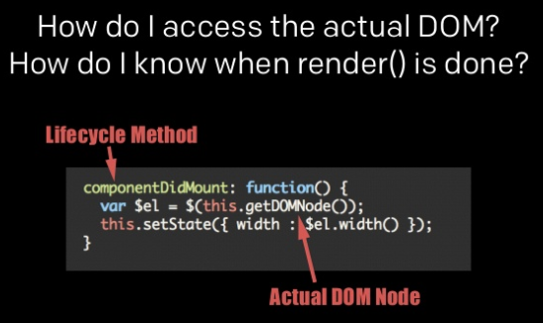
Virtual DOM - How’s?

Slide 46
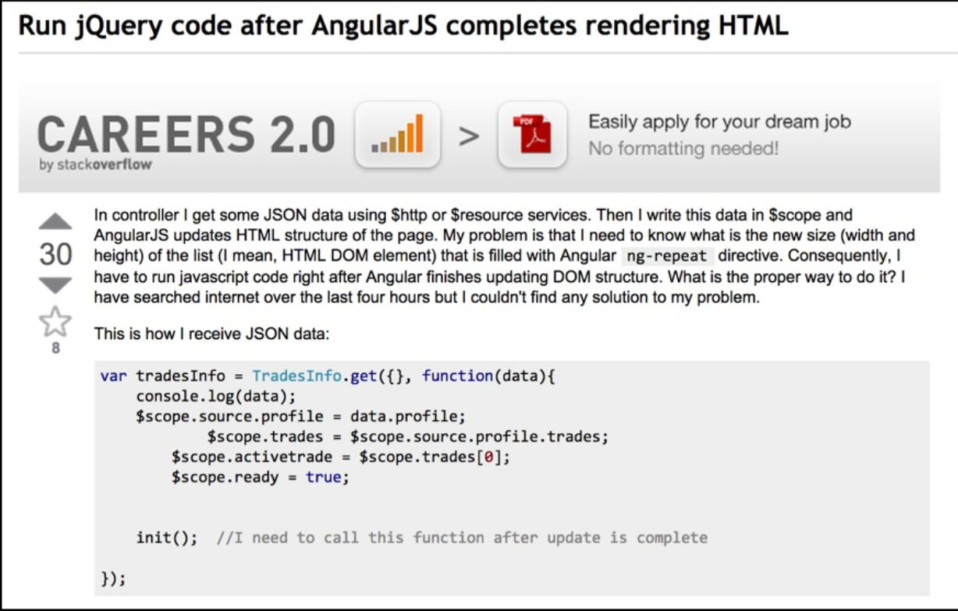
Declarative Syntax

Slide 47
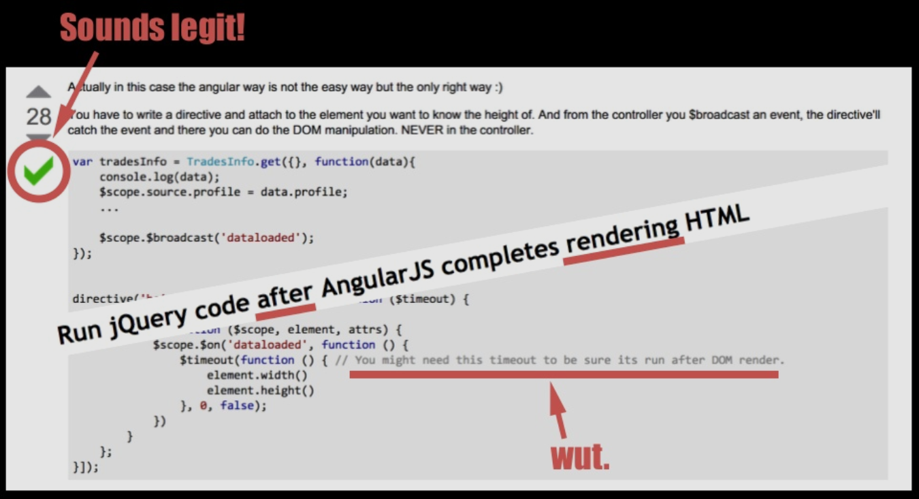

Slide 48
Why React is awesome?
One way dataflow keeps complexity under-control
You really know this changed because of that! Blame game!
Easy to debug - Self contained components
Library doesn’t dictate too much!
Simple and easy to learn

Slide 49

Hello React Native

Slide 50
React Native
Build world-class application experiences on native platforms using JS & React
Learn once, write anywhere - Increase Developer efficiency
Use the standard native/platform components, in react(JS) way
Based on ReactJS in the latest versions
Pre-requisites - ES6 & ES7!
Asynchronous programming!
Flexbox layout model from Web to Mobile
Powerful touch handling
Polyfills - use npm/JS libs such as XMLHttpRequest, navigator.geolocation etc.,
Extensibility - Create native modules on Both Android & iOS

Slide 51
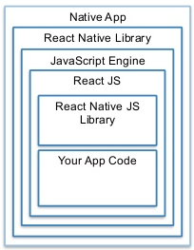
Architecture

Slide 52
Prerequisite Knowledge
Javascript!
ES6(Promises, Arrow functions, Generators)
ES7(Async, Await)
Basics of NPM
How to setup Android Studio ;)

Slide 53
Installing react-native command line
npm install -g react-native-cli
‘react-native’ will be available as a command henceforth

Slide 54
Create first React Native project
Create the project
react-native init AwesomeProject
Start the local server
react-native start
Run the application on Android phone
react-native run-android

Slide 55
Demo
Basic structure of React Native project
Components
Styling
React Native components on Github
UIExplorer
Movies App

Slide 56
React Native Material Design
Started by binggg
Later moved to an organization and taken over by Elliot Hesp & Satvik Jagannath
Best UI for react native
Link : Github

Slide 57
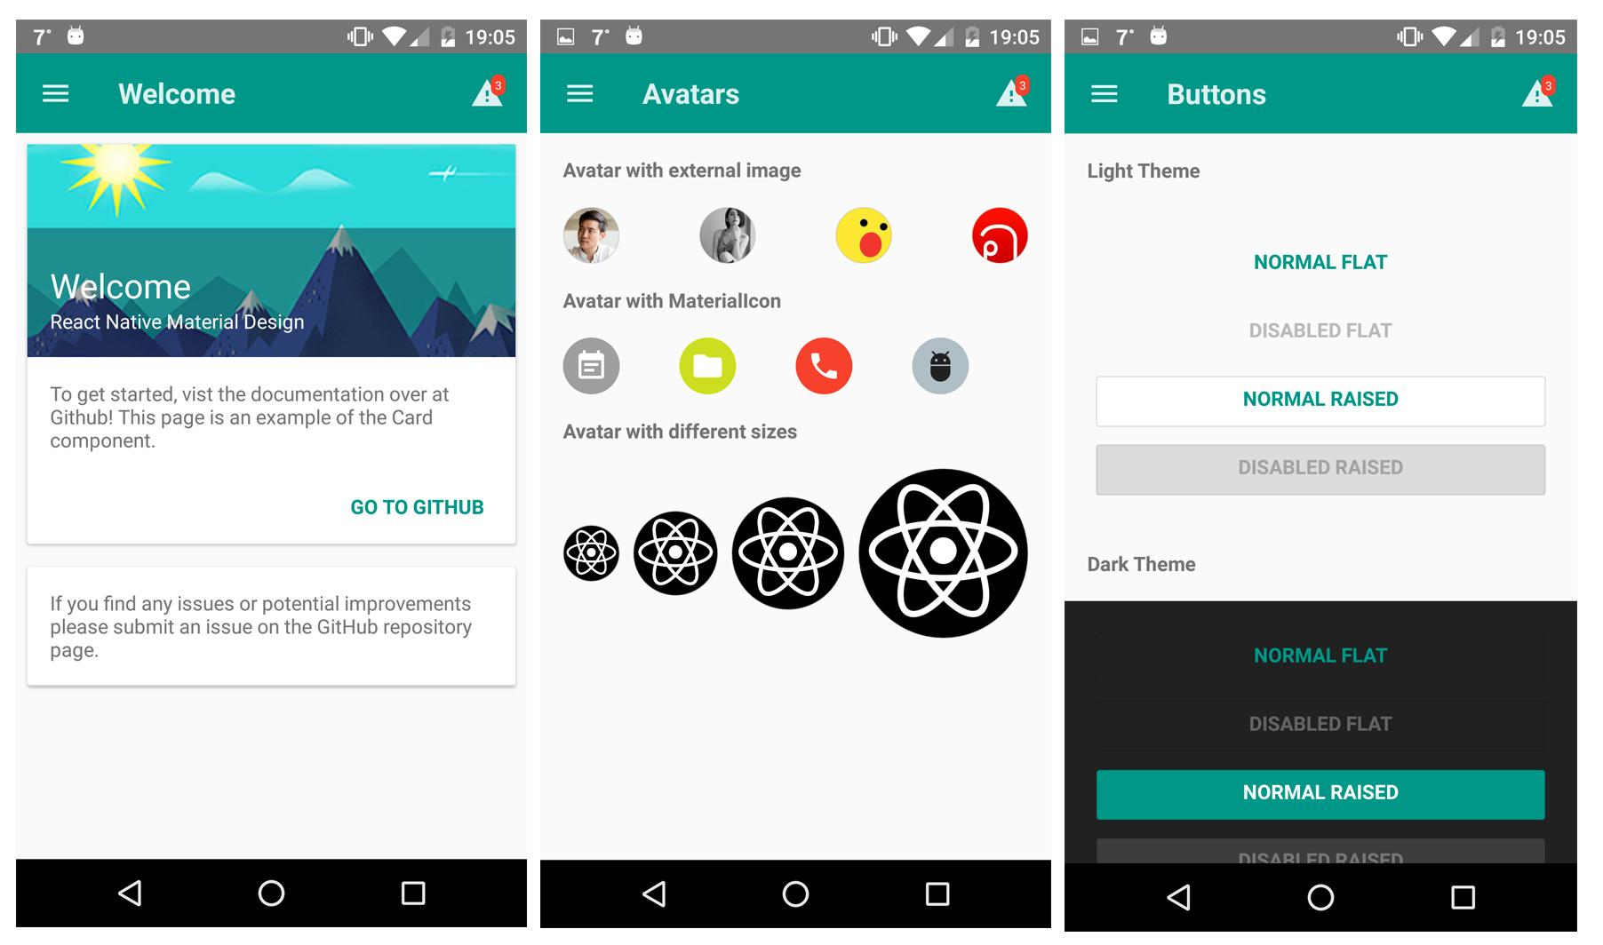
Screenshots

Slide 58
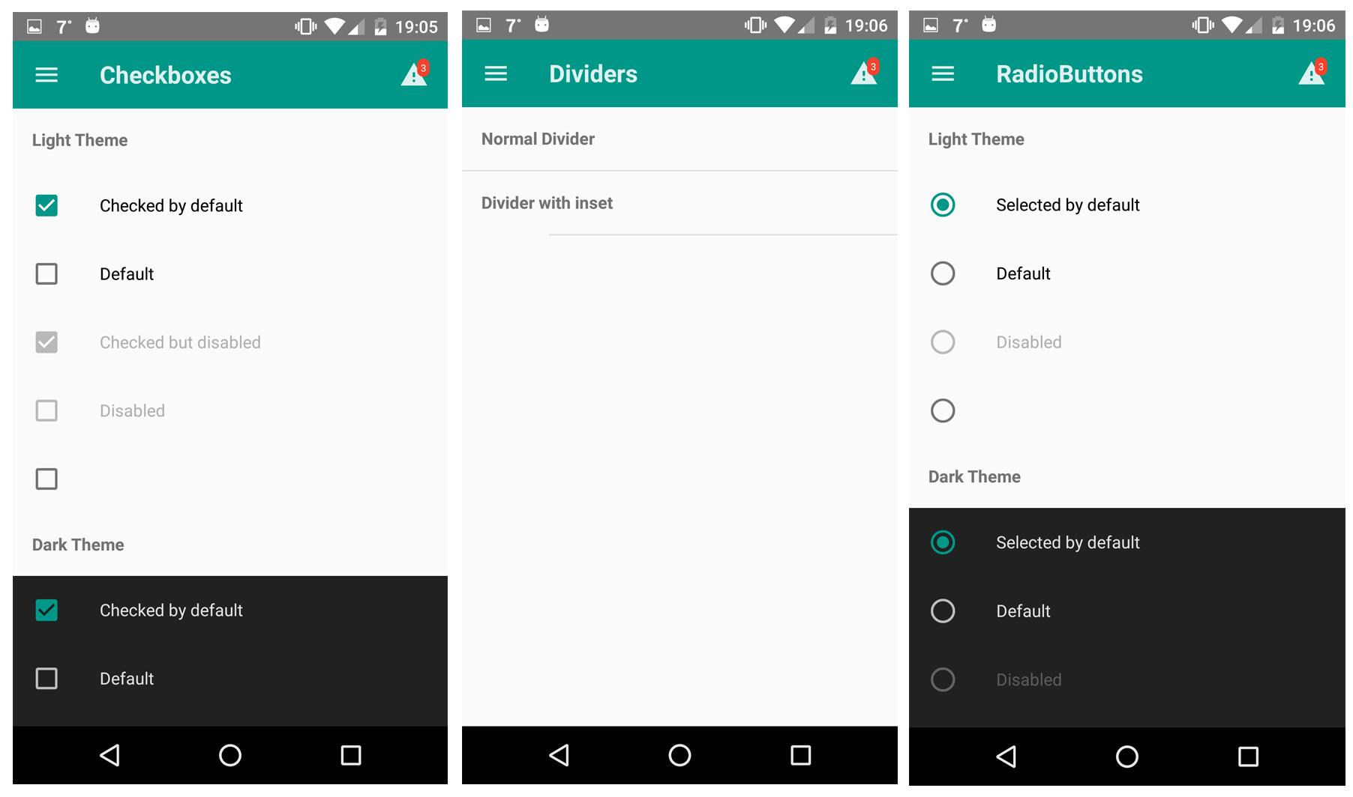
Screenshots

Slide 59
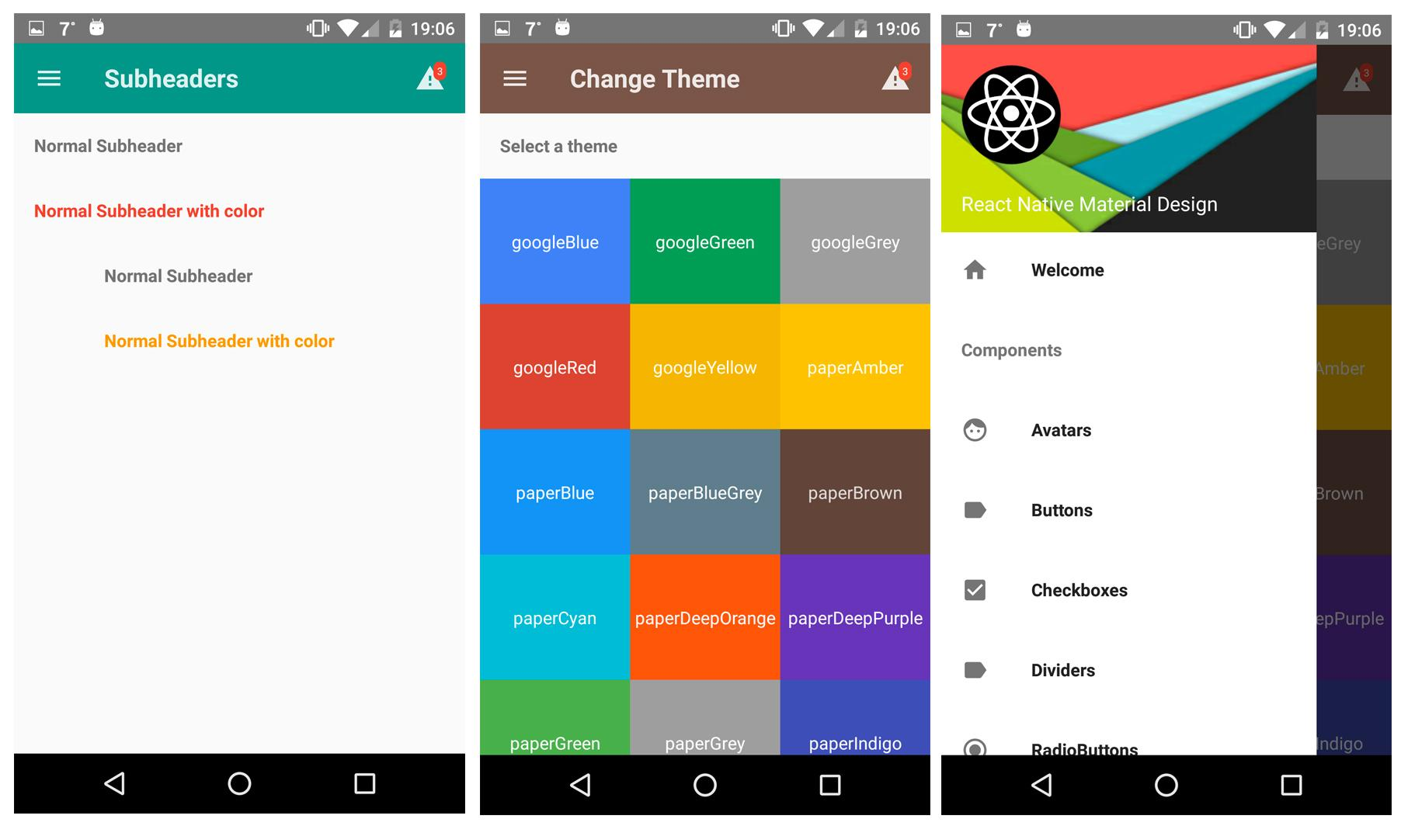
Screenshots

Slide 60
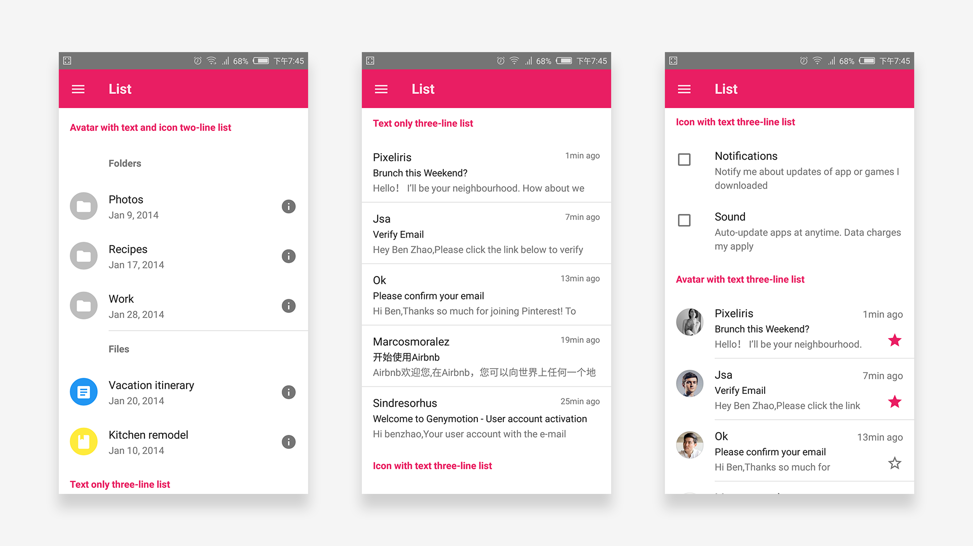
Screenshots

Slide 61
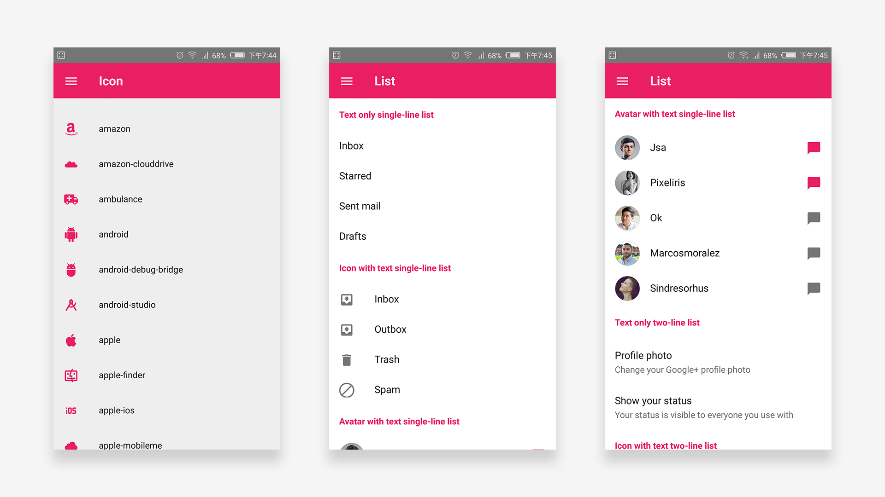
Screenshots

Slide 62
What’s next?
React Native API’s are stable
React Native is fully based out of ReactJS
Maybe the next big thing!
Watchout-
Have a look at latest updates on react-native-material-design
Flat-UI coming soon...

Slide 63
Thanks...
Facebook - Framework
Kyle Simpson - You Don’t Know JS
Hemanth H.M. - Showing me the taste of React
Andrew Hull - images

